Slide 1
Second Conscience

Slide 2




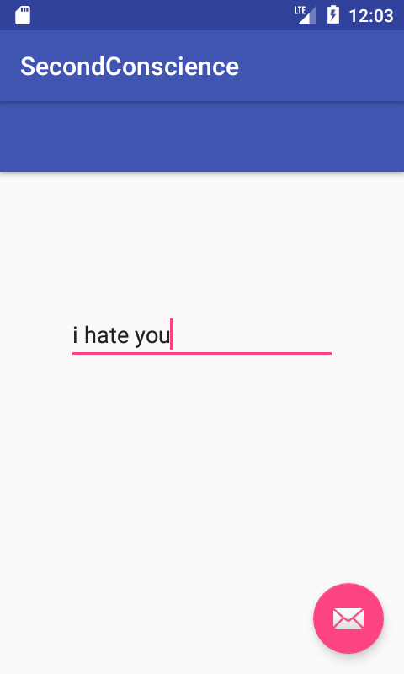



Text Analytics
Bing Spell Check
<HTTP Trigger>
POST Bullying Request
Language Understanding Intelligent Service
App Center

Slide 3
DEMO VIDEEEEEEEEEEEEEEEEEEEEEEEEEEEO

Slide 4
CHARTS

Slide 5
bit.ly/SecondConscience

